Slide 1
The Scrum Process Week2
Universidad para la Cooperación Internacional

Slide 2

¿What is Scrum?
https://www.youtube.com/watch?v=2Vt7Ik8Ublw

Slide 3


¿What is Scrum?
A framework within which people can address complex adaptive problems, while productively and creatively delivering products of the highest possible value.
Lean Production
From
Agile perspective
Focus on value to
Customer
Sprint
Customer centric
Muda
Eliminated waste
Mura
Muri
Pull

Slide 4
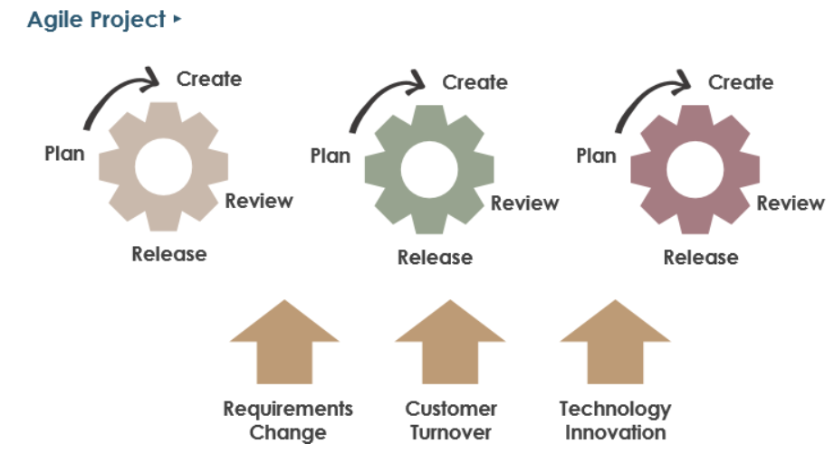
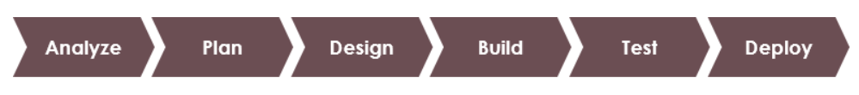
Empirical Process in Scrum
Learn as we progress
Expect and embrace change
Inspect and adapt using short development cycles
Estimates are indicative only and may not be accurate
Empirical Scrum Process
Regular Project Process

Slide 5
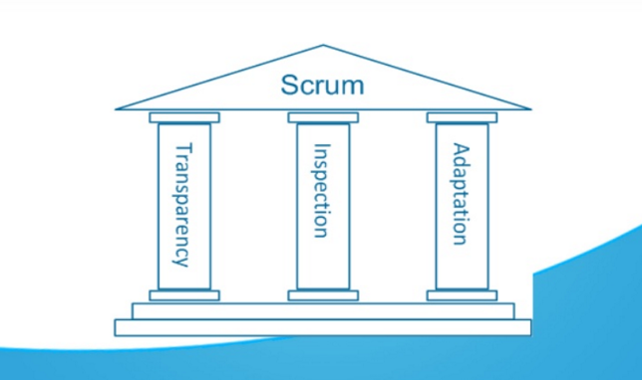
Scrum Pillars

Slide 6
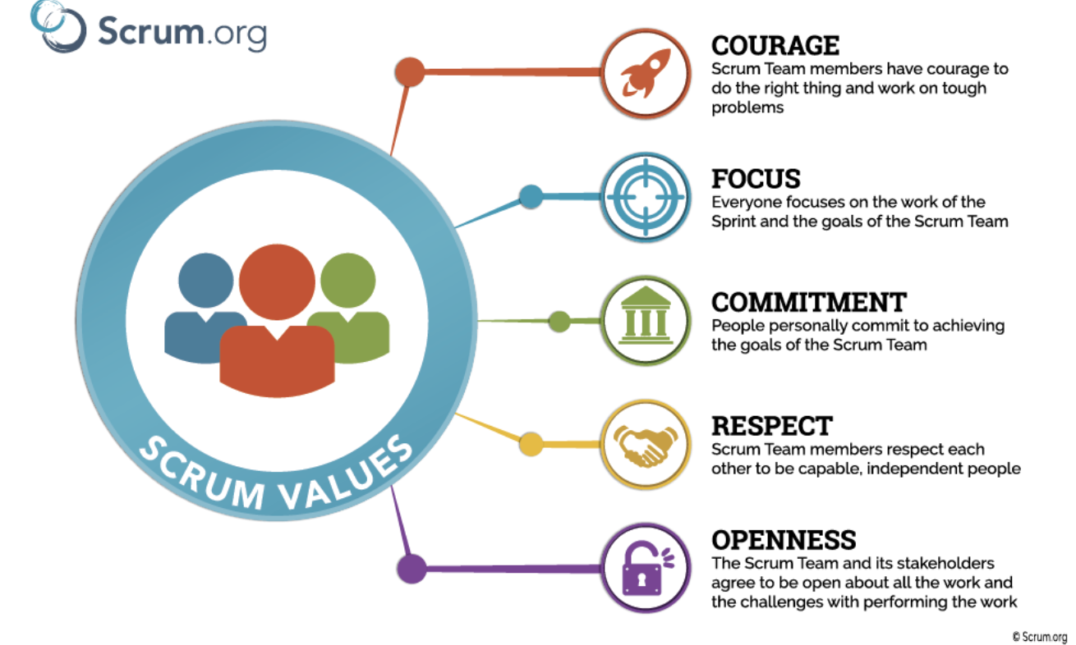
Scrum Values
FORCC

Slide 7

Scrum A/D
Advantages
Disadvantages
Customer expectations management
Works better in small groups
Predict results
Required a exhaust effort to detail every task and plan
Embracing change
High qualification for those who are involved
Systematic Risk Management

Slide 8
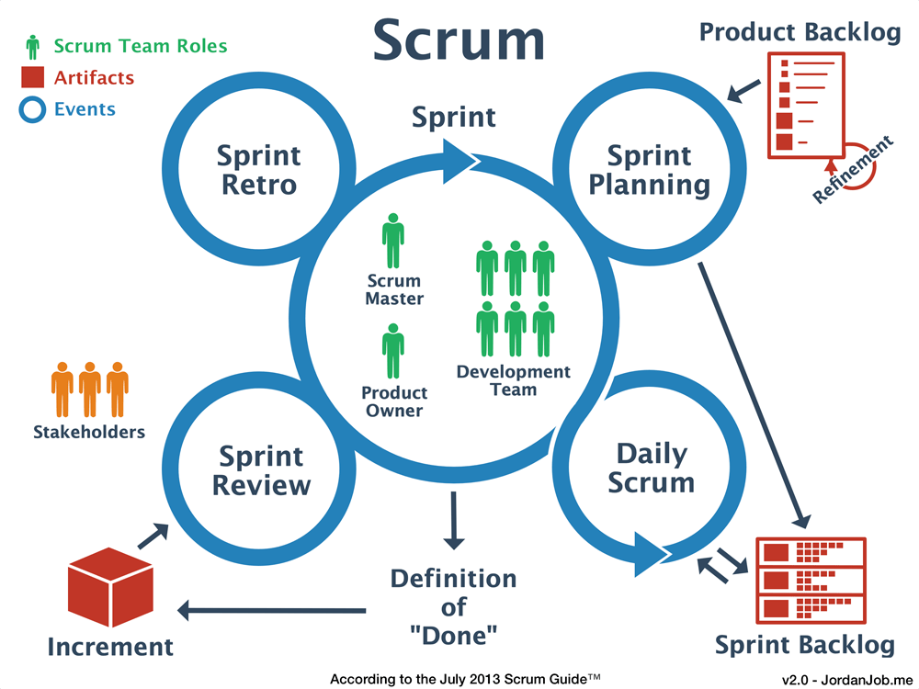
How does the scrum process work?
TRANSPARENCY
INSPECTION
ADAPTATION
3 PILLARS
Notes:
Cómo se configura un ELT, sus objetivos (para que existen) y su relación con los equipos 360
Mostrar Estructura Propuesta
Evitar el comando y control
Equipo definen visión, enfoque, eliminar impedimentos, mejora continua,
Declarar experiencias, para lanzar equipos
Ustedes van a estar al servicio de ellos, apoyándolos, definiéndole la visión,

Slide 9
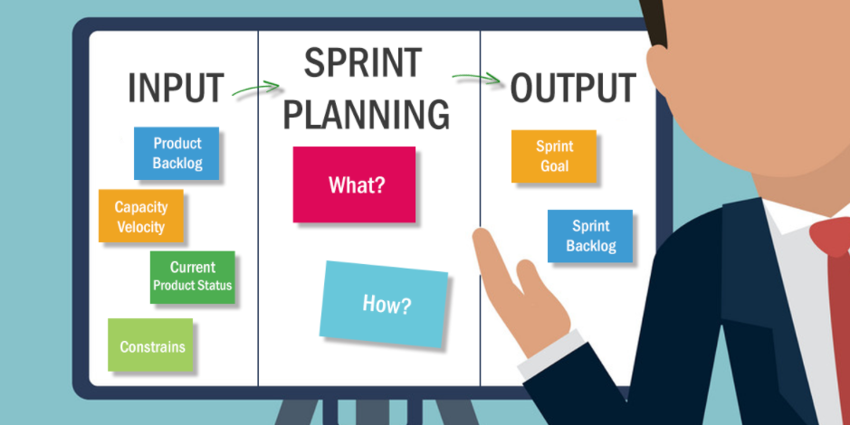
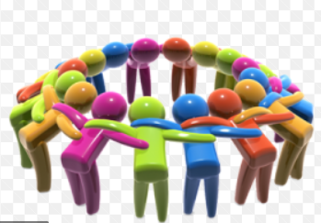
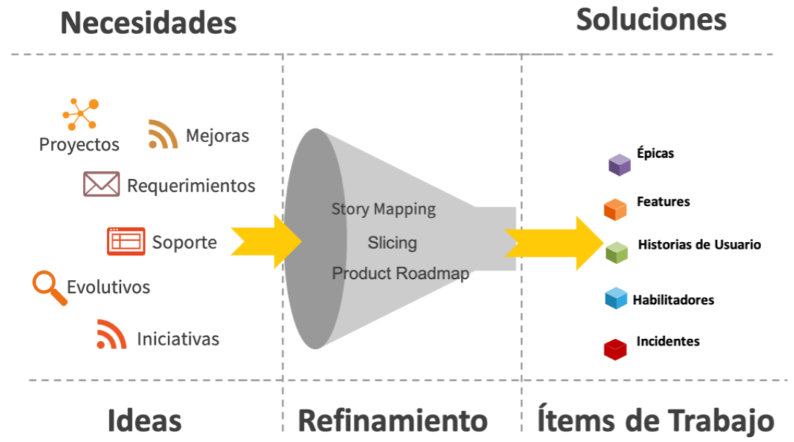
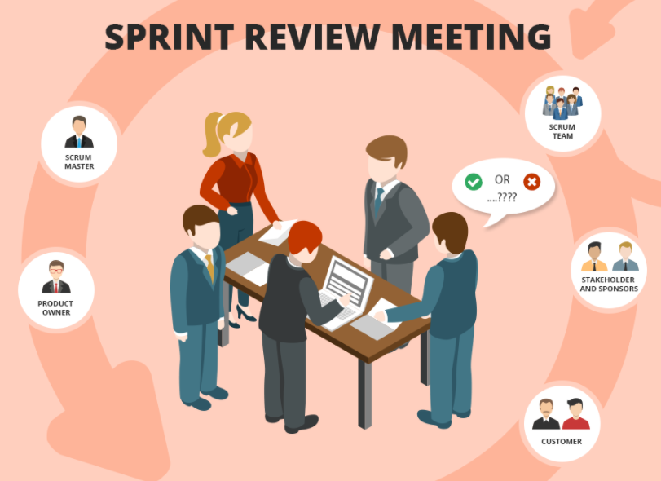
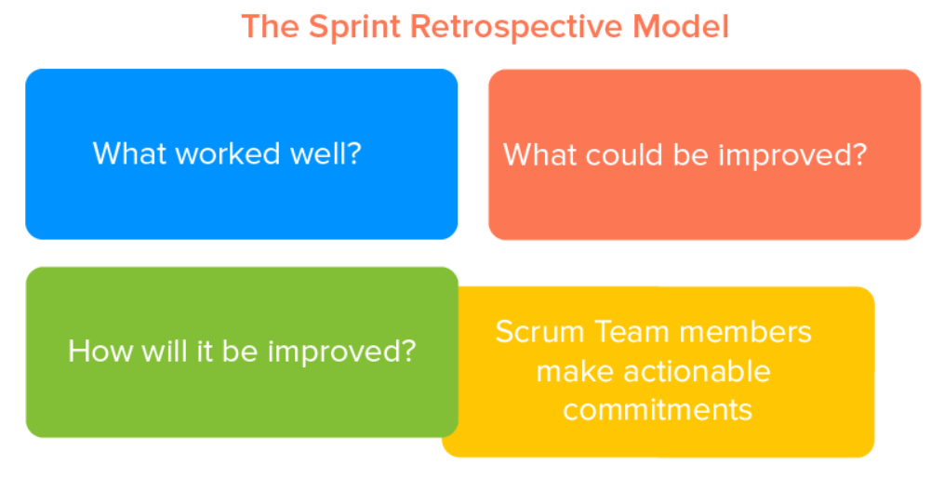
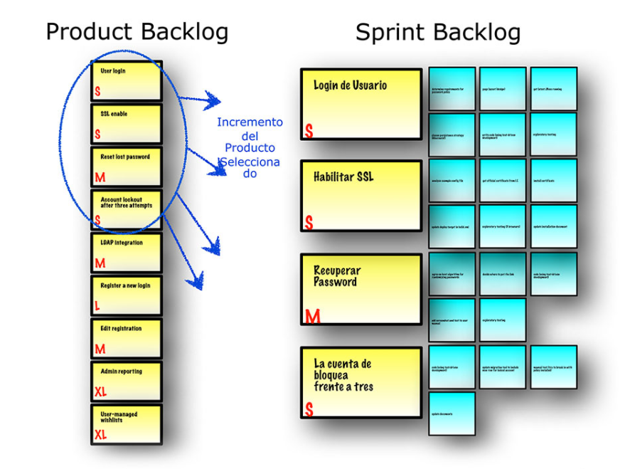


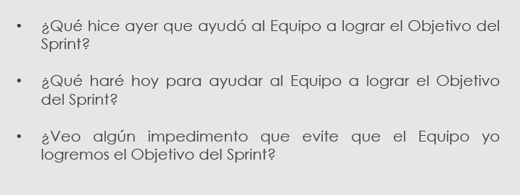
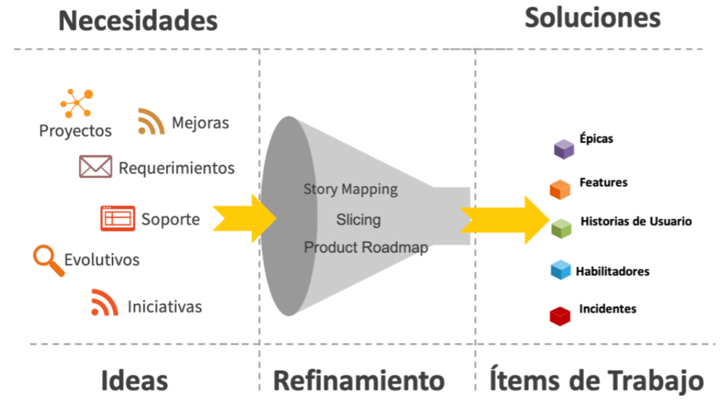
Scrum Events
SPRINT PLANNING
DAILY SCRUM
REFINEMENT
SPRINT REVIEW
RETROSPECTIVE
What to do in a sprint plannin? https://www.youtube.com/watch?v=9NWbQlRcdh0
What to do in a Daily Scru? https://www.youtube.com/watch?v=er9gntPjTJU
What to do in a Refinement? https://www.youtube.com/watch?v=pSguy2FuC2c
What to do in a sprint review? https://www.youtube.com/watch?v=InXAS_zRvqQ
What to do in a retrospective? https://www.youtube.com/watch?v=9NWbQlRcdh0
Ceremony
Sprint Backlog
Work to be done (user stories), impedments, identify improvements and the strategy (sub-task) to complete them.
Strategic of the day:
What did I do yesterday? What will you do today? Is there any impediment?
Two Sprints ahead ¡READY!:
User stories, impediments and improvements ready! To be work by the team
Demo ¡DONE!
User stories, impediments and improvements DONE! During the sprint by the team
Metrics up-today.
Process improvement plan:
What did we do right? What did we do wrong? What are the improve actions for the followings sprints?
RESULTS

Slide 10
Professor Carlos Castro Torres
ccasto2512@gmail.com

