Slide 1
Scrum Roles Week3
Universidad para la Cooperación Internacional

Slide 2
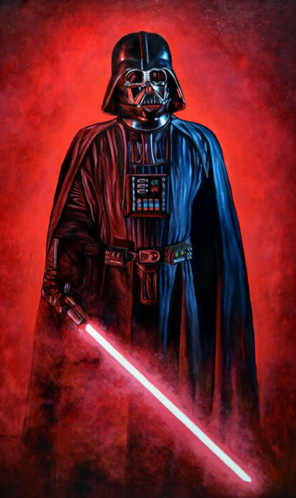
Scrum Master (SM)
Works with the organization to make Scrum possible
Ensures Scrum is understood and enacted
Creates an environment conducive to team self-organization
Shields the team from external interference and distractions to keep it in group flow (a.k.a. the zone)
Promotes improved engineering practices
Has no management authority over the team
Helps resolve impediments
Has a leadership role

Slide 3
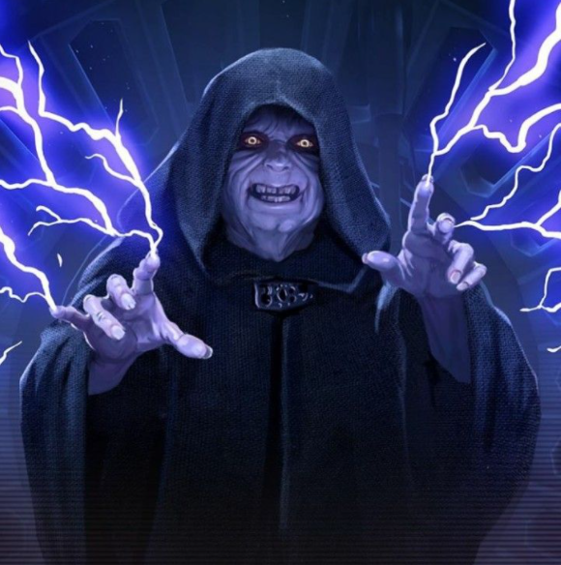
Product Owner (PO)
Single person responsible for maximizing the return on investment (ROI) of the development effort
Responsible for product vision
Constantly re-prioritizes the Product Backlog, adjusting any long-term expectations such as release plans
Final arbiter of requirements questions
Decides whether to release
Decides whether to continue development
Considers stakeholder interests
Has a leadership role

Slide 4

Developement Team
Cross-functional (e.g., includes members with testing skills, and often others not traditionally called developers: business analysts, designers, domain experts, etc.)
Self-organizing / self-managing, without externally assigned roles
Plans one Sprint at a time with the Product Owner
Has autonomy regarding how to develop the increment
Intensely collaborative
Most successful when located in one team room, particularly for the first few Sprints
Most successful with long-term, full-time membership. Scrum moves work to a flexible learning team and avoids moving people or splitting them between teams.
10 or less members
Has a leadership role

Slide 5
Scrum Master (SM) skills

Slide 6
Scrum Master is not…
A Team, a Project or funtional manager
Somebody with the authority over the team
A team leader
An easy Role
Necessary a team member
Necessary the most team expert

Slide 7
SCRUM MASTER | FACILITATING
Plan and facilitate Scrum meetings
Manage discussions
Make sure people keep the right focus
Manage meeting results
Facilitate the retrospective meeting (KAIZEN EVENT)
Facilitate communication between the team and the Product Owner Establish and manage agreements between the team
Help in the Impediments resolution

Slide 8
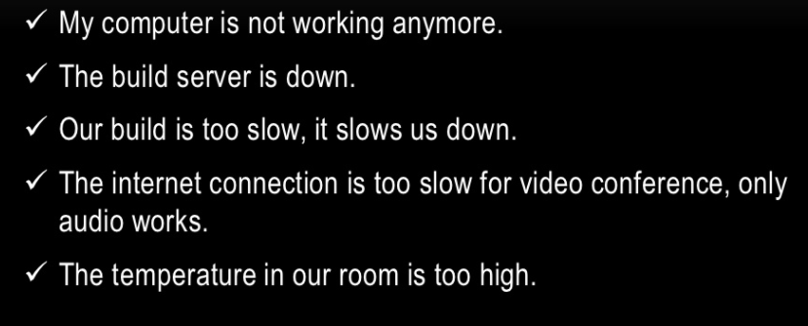
A few examples

Slide 9
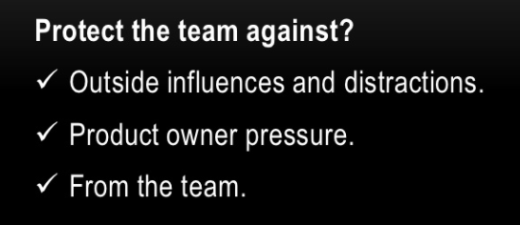
SCRUM MASTER | PROTECT THE TEAM

Slide 10

SCRUM MASTER | PROTECT THE TEAM
From What?
  Over commitment
  Complacency
  People outside the team

Slide 11
SCRUM MASTER | COACHING THE TEAM
Help the team solve problems
Conflicts between the team
Conflicts between the team and stakeholders
Educate the team on the Scrum process
Guide the team in performance

Slide 12
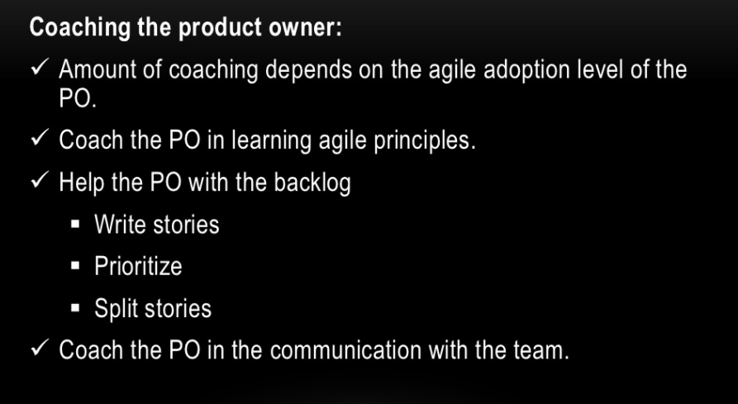
SCRUM MASTER | COACHING THE PRODUCT OWNER

Slide 13
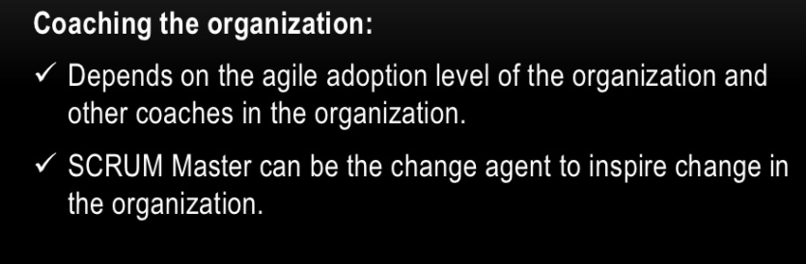
SCRUM MASTER | COACHING THE ORGANIZATION

Slide 14
Product Owner

Slide 15
Product Owner = Owner of WHAT
Have a compelling vision of the product, which is executable, generates a lot of money, generates passion in the Service team, the company and the clients.
Build a "roadmap" for the development of the vision, which everyone can see and sign up
Create a backlog of specifications that are: sufficient and to Time
Service Leader Spend half of the time with customers, sales and Marketing.
The other half works closely with the Service Team clarifying the Specifications.
Lead the grooming of the Backlog.
Notes:
Johnny

Slide 16
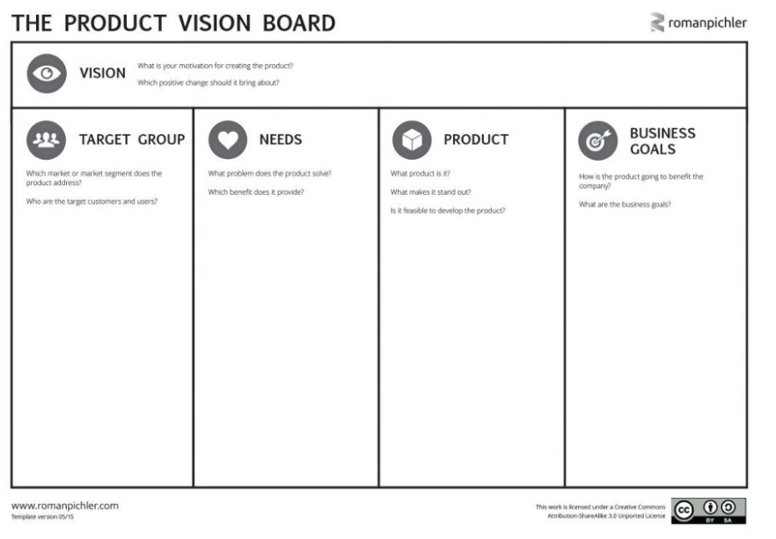
Product Vision Board

Slide 17
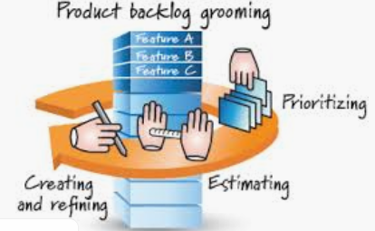
Product Owner - Backlog Grooming
Notes:
Charlie

Slide 18
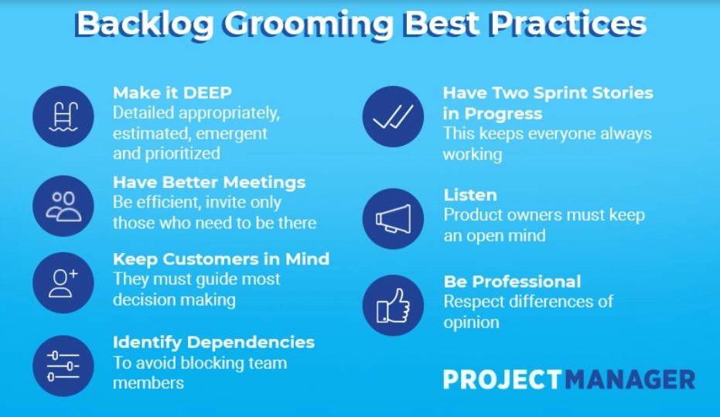
Responsabilidades del Product Owner- Backlog Grooming
Notes:
Charlie

Slide 19
Product Owner Analysis
https://www.youtube.com/watch?v=502ILHjX9EE
Notes:
Johnny

Slide 20
Development team

Slide 21
Development Team
SDT=Development Team
Multifunctional (includes members with testing skills and often others not traditionally called developers: business analysts, domain experts, etc.)
Self-organized / self-managed, no externally assigned roles
Negotiate commitments with the Product Owner, one Sprint at a time
Has autonomy with regard to how to achieve its commitments
Intensely collaborative
It has a greater probability of success when it is established in the same place, especially for the first Sprints
Team more successful if everybody is involved with the team in long-term and full-time.
Scrum promotes avoiding the transfer of people or dividing them among other teams.
10 or less members
Has a leadership role

Slide 22
Team Self-Organization
https://www.youtube.com/watch?v=eFB2BLpByXw

Slide 23
Challenges and opportunities
Members are committed to clear, short-term goals
Members can gauge the group’s progress
Members can observe each other’s contribution
Members feel safe to give each other unvarnished feedback

Slide 24
Professor Carlos Castro Torres
ccastro@uci.ac.cr

